Slide 1
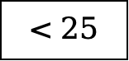
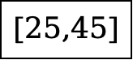
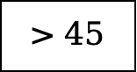

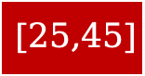
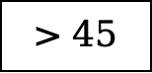
African-American
Male
Female
$$<25$$
$$[25,45]$$
$$>45$$
$$<25$$
$$[25,45]$$
$$>45$$

Slide 2
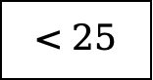
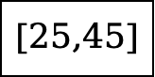
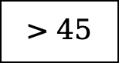
African-American
Male
Female
$$<25$$
$$[25,45]$$
$$>45$$
$$<25$$
$$[25,45]$$
$$>45$$

Slide 3

age $<25$
Male
Female
Afican-American
Caucasian
Hispanic
Asian
Native American
Other

Slide 5

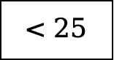
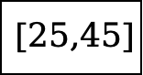

Caucasian
Male
Female
$$<25$$
$$[25,45]$$
$$>45$$
$$<25$$
$$[25,45]$$
$$>45$$

Slide 6


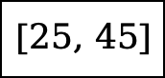
Female
$$< 25$$
$$[25, 45]$$
$$> 45$$
African-American
Caucasian
Hispanic
Other
African-American
Caucasian
Hispanic
Native American

